Slide 1
Secure Your ASP.NET WebApi and MVC Applications
Bob Walker
Lead Application Developer - Farm Credit Services of America

Slide 2

About
Developer since 2004
Lead Application Developer for Farm Credit Services of America
Previously worked for TelventDTN (later Schneider Electric), West Corporation, and Sandhills Publishing
Married in 2015
Passions: Software Development, Cycling, Photography
Founder: CodeAperture.io

Slide 3
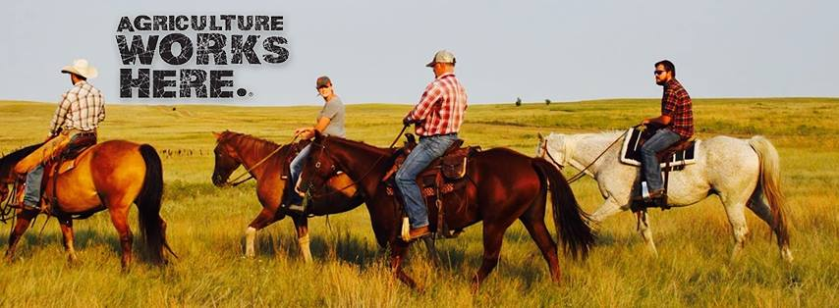
Farm Credit Services of America
Association in Farm Credit System which started in 1916
Lending institution providing credit to 1/3 of rural America
Types of loans
Budget
Line of Credit
Real Estate
Country Home Loan
My Team is responsible for one of the loan origination systems

Slide 4
Bad People Are After…

Slide 5
Not our (unlimited) free Soda

Slide 6
Nor our wicked awesome Coffee Machine

Slide 7
Cash Money

Slide 8
Customer Information

Slide 9
100% Security is Impossible

Slide 10
We Exist to Serve…

Slide 11


Slide 12
Have realistic security expectations

Slide 13


Slide 14
There is a struggle between usability and security

Slide 15
But users don’t always make smart choices

Slide 16


Slide 17
Security Mindset

Slide 18
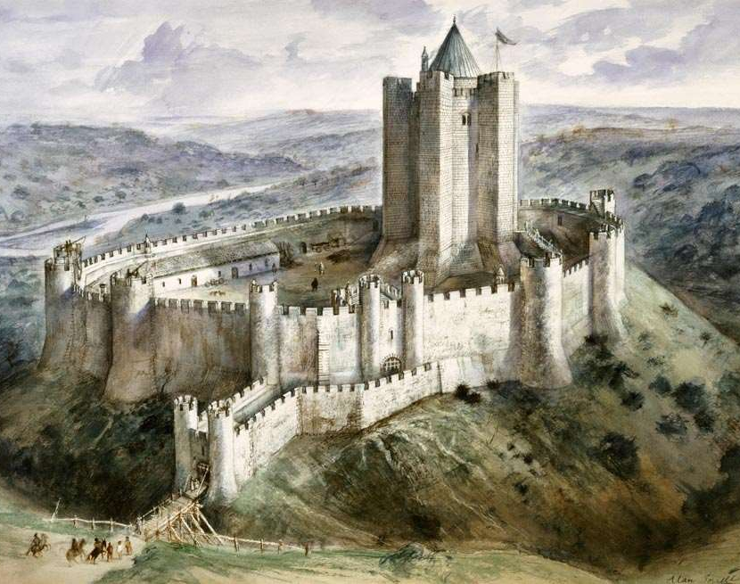
Layers Of Security
Authentication
Authorization
Data Validation
Content Filters
Action Filters
Encryption
Hashing
Code Reviews
White-Hat Hacking
Code Analysis

Slide 19
Think At Application Level

Slide 20
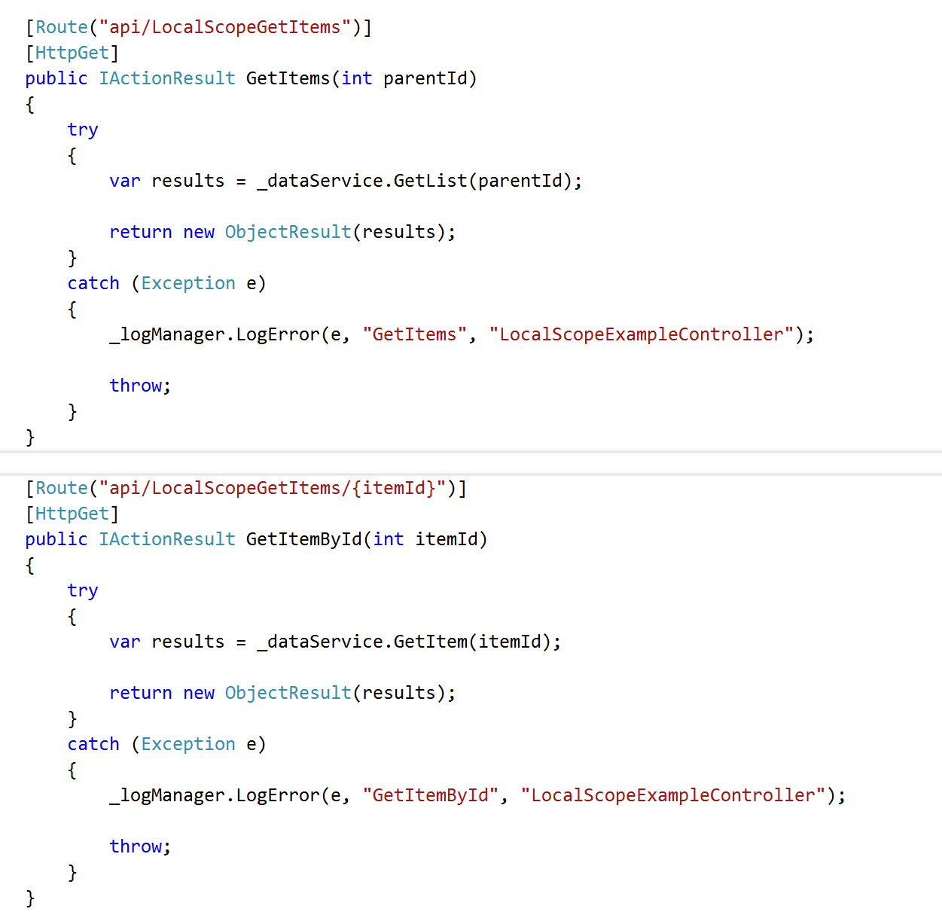
Local Exception Handling

Slide 21
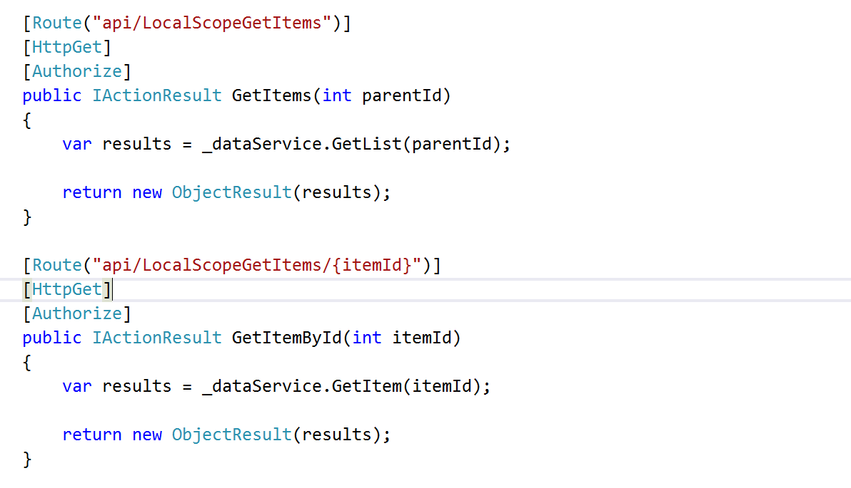
Local Authorization

Slide 22
The Issues
Developers will forget (we’re human!)
Inconsistency
More code to maintain
Duplicated code

Slide 23
It’s Mathematics
20 WebApi Controllers
x 4 Method Per Controller (CRUD)
= 100 Attributes
50 WebApi Controllers
x 4 Method Per Controller (CRUD)
= 200 Attributes

Slide 24
Apply Changes at Application Level

Slide 25
Application Level Security Settings
Web.config / App.config
Global.asax
Exception Filters
Action Filters

Slide 26
Configuration Changes

Slide 27
Content Security Policy

Slide 28
Cross-Site Scripting (XSS)

Slide 29
Content Security Policy
Response Headers
Whitelist of acceptable sources / Blacklist of unacceptable sources
Types
JavaScript
Images
CSS
Websocket
Disables inline CSS, eval function, setTimeout, setInterval, DOM event handlers

Slide 30
Content Security Policy Demo

Slide 31
Cookie Policies

Slide 32
Session Hijacking
An Attacker using XSS is able to hijack session cookies

Slide 33
Cookie Policy Demo

Slide 34
Exception Filter

Slide 35
Exceptions are major security risk
Same information to debug problems is used by attackers
SQL Exception
Query Ran
Column Name
Table Names
Exception on REST calls
End Point Hit
Parameters
Headers

Slide 36
Exception Filter
Handles all errors thrown
Logs Error Details for development team
Only Exposes Minimum Information to user
Configured in Global.asax file

Slide 37
Exception Filter Demo

Slide 38
Action Filters

Slide 39
Action Filters
Custom Business Logic to enforce security
Can run before or after request is complete
All Action Filters must run before controller method is run
Able to access dependency injector
Configured in Global.asax file

Slide 40
Loan Application Action Filter
Loan Cannot Be Edited When
It is in “completed” state
Opened by another user
User is viewing in read-only mode

Slide 41
Action Filter Demo

Slide 42
Database Protection

Slide 43
Configuration
Don’t store username/password in web.config
Don’t grant rights to built in roles for application service account
Grant permissions at schema level
Grant select to dbo
Grant CRUD to custom schema
Use different service accounts per application

Slide 44
Entity Framework
Create base context to inherit from dbcontext
Inject custom rules on save changes method

Slide 45
SDLC Improvements

Slide 46
Automated Testing
Security Exploits are often times nothing more than a missing test case
Unit Tests
Service Tests
UI Tests

Slide 47
White-Hat Hacking
Have other developers try to hack your site
Be as evil as you can be
Get permission first!

Slide 48
Code Reviews

Slide 49
Plan when compromised
Intrusion detection
Response
Data Cleanup
Customer Notification

Slide 50
It’s not a matter of if but when

Slide 51
Not all doom and gloom

Slide 52
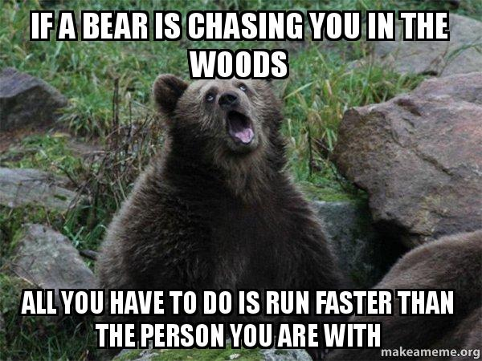

Slide 53
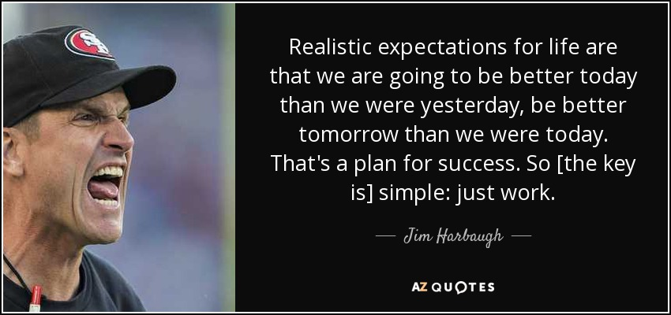

Slide 54
Questions?

Slide 55
Thank you!
Follow @CodeApertureIO
Email: bob.walker@codeaperture.io
Download: https://github.com/CodeAperture/HDC2016

